Slide 1
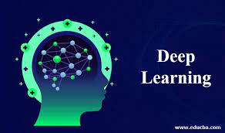
Image Scraping and Classification Project
Using Deep Learning
Project By -
Shivani Angadi
(Internship 14)

Slide 2
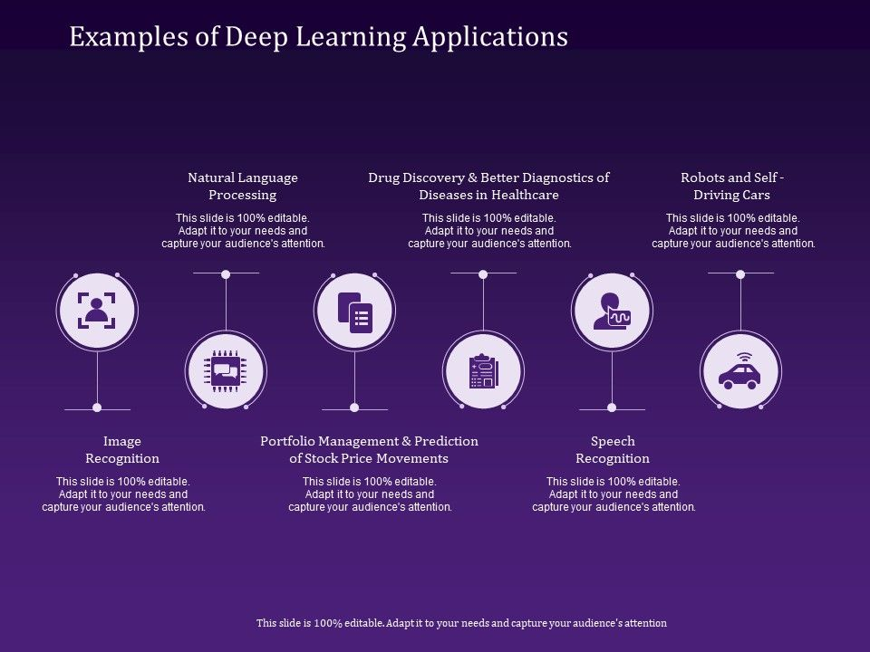
Uses Cases of Deep Learning

Slide 3
Project Description
Data Collection
In order to sustain the robustness of model, images are scrapped from an e-commerce website, www.amazon.com.
The images to be scrapped is from the clothing category which comprises of -
Sarees (women)
Trousers (men)
Jeans (men)
Data in each category consists of 300 images. Images are scrapped using web scraping tools such as Selenium & BeautifulSoup.

Slide 4
Model Building
The task is to build a model on image classification that will help in differentiating between the three different categories using Deep Learning Mechanisms.
Use of image augmentation, image transformations such as resizing of images have been made for the model to learn training images efficiently.
Use of Transfer Learning technique has been made to train the images and then performing testing on the test data set.

Slide 5
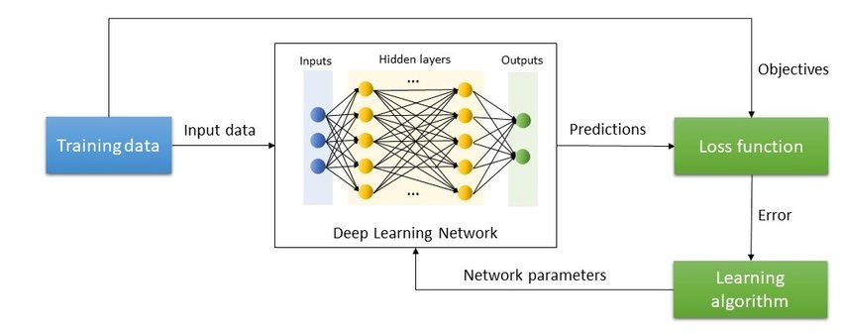
Deep Learning Process

Slide 6
Research and Solution
An image dataset of clothing category is scrapped and used to analyze how these clothing varieties of men & women differ from each other.
The images are resized and transformed using ImageDataGenerator object and uploaded onto Google drive through which colab can easily access it.
We aim at implementing a model performing:
Feature Extraction using Convolutional Operation
Classification using Feed Forward Neural Network

Slide 7
Training is performed along with different optimizations and learning rates to update the gradient to allow most efficient on Google Colab for persistent storage.
The adjustments of weights and functioning of Network is performed using Transfer Learning.
Output is derived by testing the trained model on test data set and then verifying with the accuracy obtained.

Slide 8
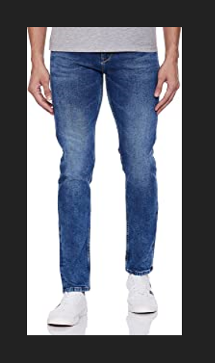
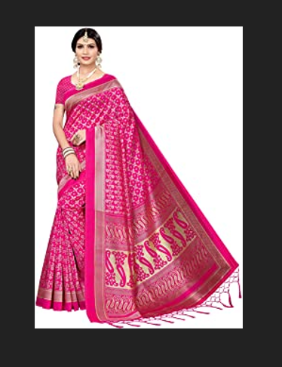
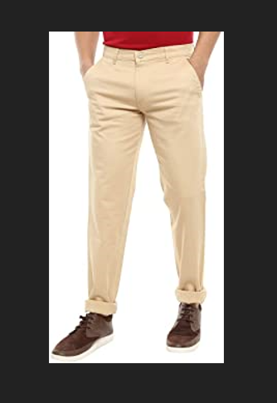
Categories of Images Scrapped
Jeans
Sarees
Trousers

Slide 9
Techniques Used
Normalization:
Normalization is a method used in artificial neural networks to change the values of columns in data set to a common scale without distorting differences in range of values.
Convolutional Neural Network:
Convolutional Neural Network, also known as CNN or ConvNet, is a class of neural network that specializes in processing data that has a grid-like topology, such as an image. A digital image is a binary representation of visual data. It contains a series of pixels arranged in a grid-like fashion that contains pixel values to denote how bright and what color each pixel should be.

Slide 10
Transfer Learning:
Transfer Learning is a reusable algorithm which is trained on a large number of images wherein all the weights and biases have been already learnt and updated. The knowledge of this model is used on another data set to to classify images into different categories.
SoftMax Layer:
Softmax assigns decimal probabilities to each class in a multi-class problem. Those decimal probabilities must add up to 1.0. This additional constraint helps training converge more quickly than it otherwise

Slide 11
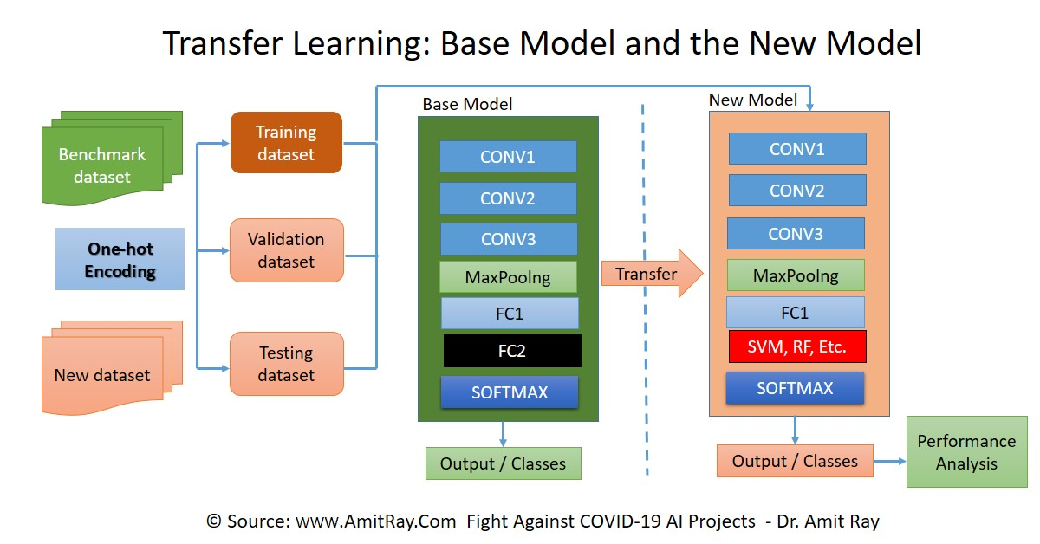

Slide 12
CNN for Classification
The image is passed through a series of Convolutional, nonlinear, pooling layers and fully connected layers, and then generates the output. The Convolution layer is always the first. Тhe image (matrix with pixel values) is entered into it.
Next the software selects a smaller matrix there, which is called a filter (or neuron, or core). Then the filter produces convolution, i.e. moves along the input image.
The nonlinear layer is added after each convolution operation. It has an activation function, which brings nonlinear property.
The pooling layer follows the nonlinear layer. It works with width and height of the image and performs a downsampling operation on them.
After completion of series of convolutional, nonlinear and pooling layers, it is necessary to attach a fully connected layer. This layer takes the output information from convolutional networks.

Slide 13
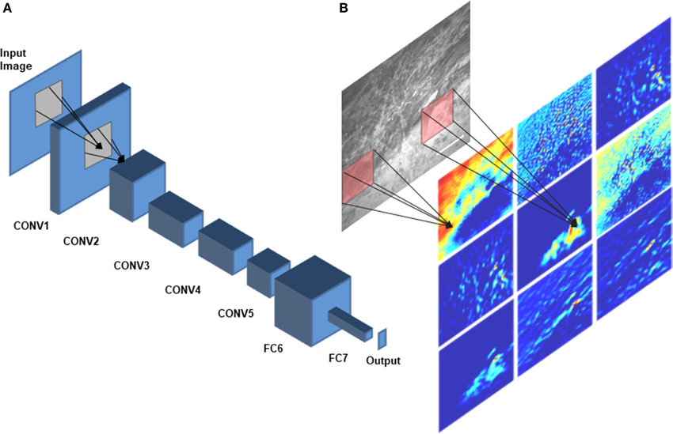

Slide 14
CNN Architecture
VGG16:
VGGNet consists of 16 convolutional layers and is very appealing because of its very uniform architecture. Similar to AlexNet, only 3x3 convolutions, but lots of filters. Trained on 4 GPUs for 2–3 weeks. It is currently the most preferred choice in the community for extracting features from images.
ResNet:
Residual Networks are the first deeper networks to be won on the ImageNet Challenge. The ResNet used at ImageNet in 2015 has 152 layers.
GoogleNet:
The winner of the ILSVRC 2014 competition was GoogLeNet(a.k.a. Inception V1) from Google. It achieved a top-5 error rate of 6.67%. This module is based on several very small convolutions in order to drastically reduce the number of parameters. Their architecture consisted of a 22 layer deep CNN but reduced the number of parameters from 60 million (AlexNet) to 4 million.

Slide 15
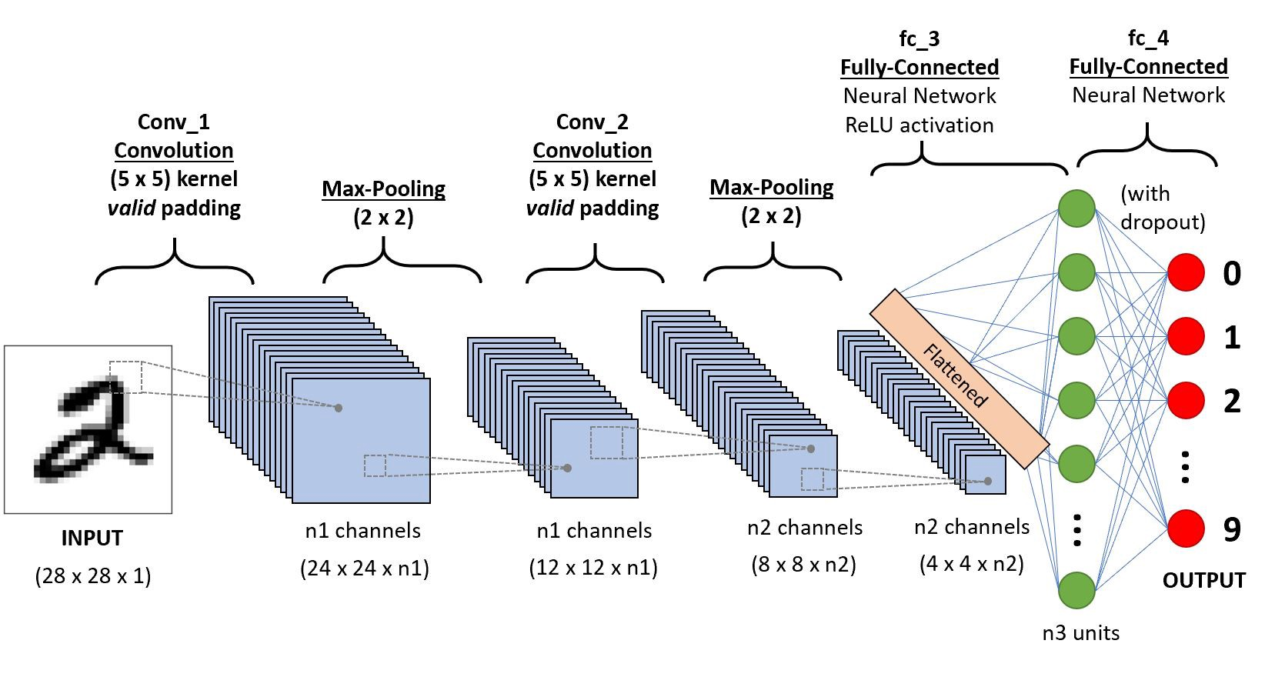
Working of CNN

Slide 16
Risk Associated
If the CUDA cache is not cleared while training it might overrun the GPU RAM.
If the image quality is not precise, it may lead to problem during training.
Model is focused on image dataset so a well structured images are required for input and functioning of systems.
The model cannot be standardized since it has been built considering only three categories of class labels and that too with the help of transfer learning.

Slide 17
Thank You..!

